Slide 1
Kubernetes Networking Model
Ref : https://sookocheff.com/post/kubernetes/understanding-kubernetes-networking-model/

Slide 2
4 distinct networking problems to address
Container-to-container communications
Pod-to-Pod communications
Pod-to-Service communications
External(Internet)-to-Service communications

Slide 3
Kubernetes Networking Model
Kubernetes imposes the following fundamental requirements on any networking implementation:
all Pods can communicate with all other Pods without using network address translation (NAT).
all Nodes can communicate with all Pods without NAT.
the IP that a Pod sees itself as is the same IP that others see it as.

Slide 4
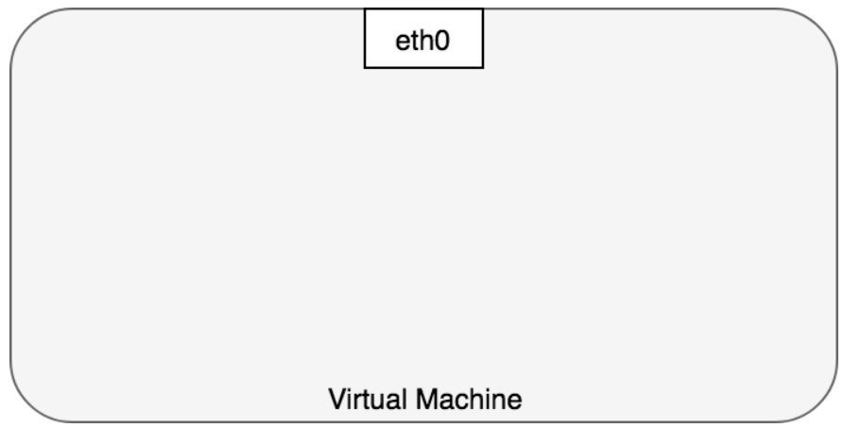
Container to container networking
Typically, we view network communication in a virtual machine as interacting directly with an Ethernet device

Slide 5
Container to container networking
Each running process communicates within a network namespace.
Network namespace provides a logical networking stack with its own routes, firewall rules, and network devices.
A network namespace provides a brand new network stack for all the processes within the namespace.

Slide 6
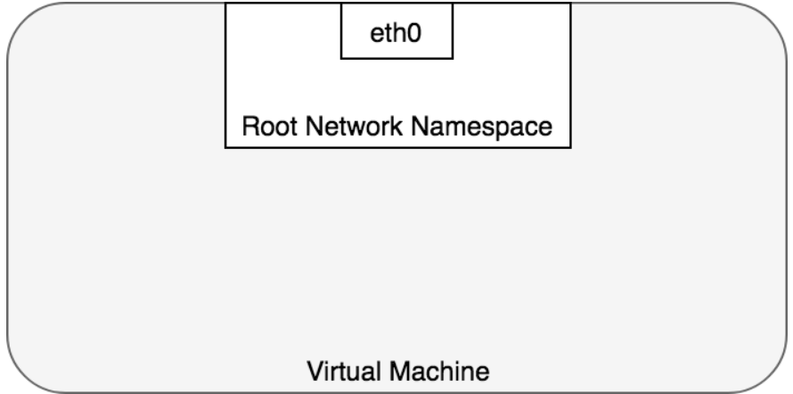
Container to container networking
Linux assigns every process to the root network namespace to provide access to the external world

Slide 7
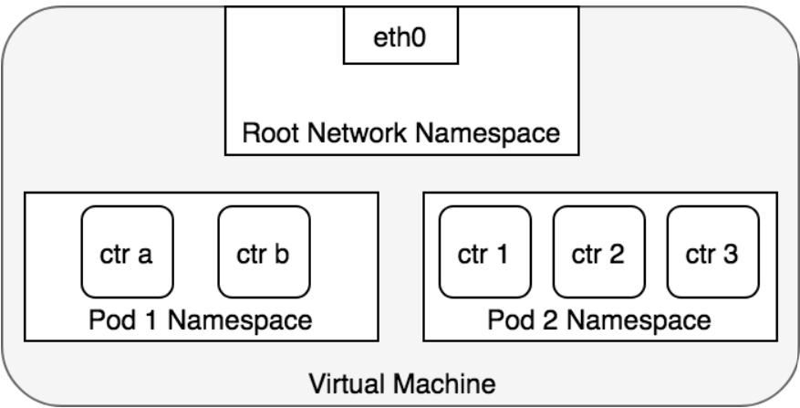
Container to container networking
Pod is modelled as a group of Docker containers that share a network namespace.
Containers within a Pod all have the same IP address and port space.
can find each other via localhost since they reside in the same namespace.

Slide 8
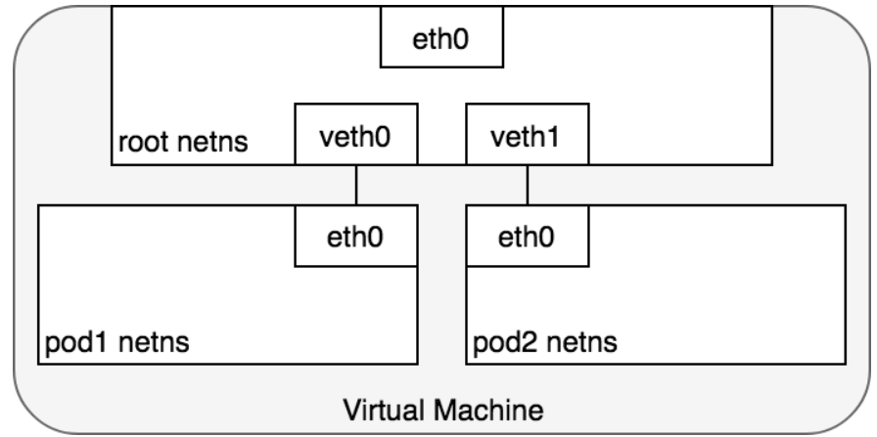
Pod to pod networking
Every Pod has a real IP address and each Pod communicates with other Pods using that IP address.
Namespaces can be connected using a Linux Virtual Ethernet Device or veth pair.
To connect Pod namespaces, we can assign one side of the veth pair to the root network namespace, and the other side to the Pod’s network namespace.

Slide 9
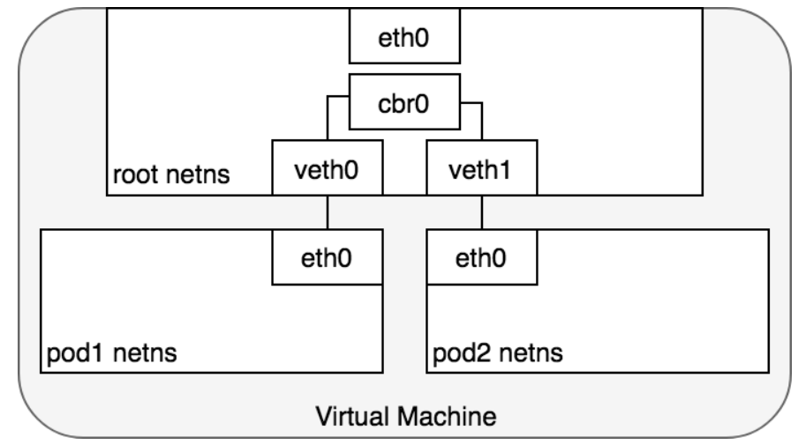
Pod to pod networking
Pods use a network bridge to talk to each other through the root namespace.
The bridge operates by maintaining a forwarding table between sources and destinations.
Bridges implement the ARP protocol to discover the link-layer MAC address associated with a given IP address.

Slide 10
Life of packet: Pod to pod, same node

Slide 11
Life of packet: Pod to pod, across nodes
Every Node in a cluster is assigned a CIDR block specifying the IP addresses available to Pods running on that Node.
Once traffic destined for the CIDR block reaches the Node, it is the Node’s responsibility to forward traffic to the correct Pod.
ARP will fail at the bridge because there is no device connected to the bridge with the correct MAC address for the packet.
On failure, the bridge sends the packet out the default route.
The Container Networking Interface (CNI) provides a common API for connecting containers to the outside network

Slide 12
Life of packet: Pod to pod, across nodes

Slide 13
Pod to service networking
Services act as an abstraction over Pods and assign a single virtual IP address to a group of Pod IP addresses.
Anywhere within the cluster, traffic addressed to the virtual IP will be load-balanced to the set of backing Pods associated with the Service.
To perform load balancing within the cluster, Kubernetes relies on the networking framework built in to Linux — netfilter.
iptables is a user-space program providing a table-based system for defining rules for manipulating and transforming packets using the netfilter framework.

Slide 14
Life of packet: Pod to service

Slide 15
Life of packet: Service to pod

Slide 16
Internet to service networking
Egress — Routing traffic to the Internet
Ingress — Routing Internet traffic to Kubernetes
Layer 4 Ingress: LoadBalancer
Layer 7 Ingress: Ingress Controller
Notes:
The load balancer is not container aware.

Slide 17
Life of packet: Pod to internet (Egress)

Slide 18
Life of a packet: Loadbalancer to service
Notes:
Once the load balancer receives the packet it picks a VM at random.
Client needs to have the load balancer’s IP address.

Slide 19
Life of a packet: Ingress to service

Slide 20
Implementation of kubernetes networking model
ACI
Antrea
Calico
Cilium
Coil
DANM
Flannel
Knitter
NSX-T
OVN

